Slide 1
Jerry’s
MKJJA - Mubarak, Kayla, Jolie, Jerry, Amna

Slide 2
What is our project about?
We set out with the goal of creating an e-commerce website for selling clothes. Our aim was to include collections for limited edition clothing releases, and to create an easily accessible shopping experience for the consumer.

Slide 3




What did we decide as the MVPs?
Homepage
Navigation
Shopping Cart
Collections

Slide 4
Why did we choose these MVPs?
Based on our previous labs, we realized how important these features are to an e-commerce website.
The homepage will navigate to the clothing release, and include the time until a clothing release to build excitement for the clothing
Collections will display the clothing from each seasonal collection, and will display backend data for each clothing item (images, price, details, sizes, colors)
The shopping cart allows for customers to add clothes to their cart, and then either continue shopping or check out their items
Navigation creates an accessible, easy to use, shopping experience

Slide 5
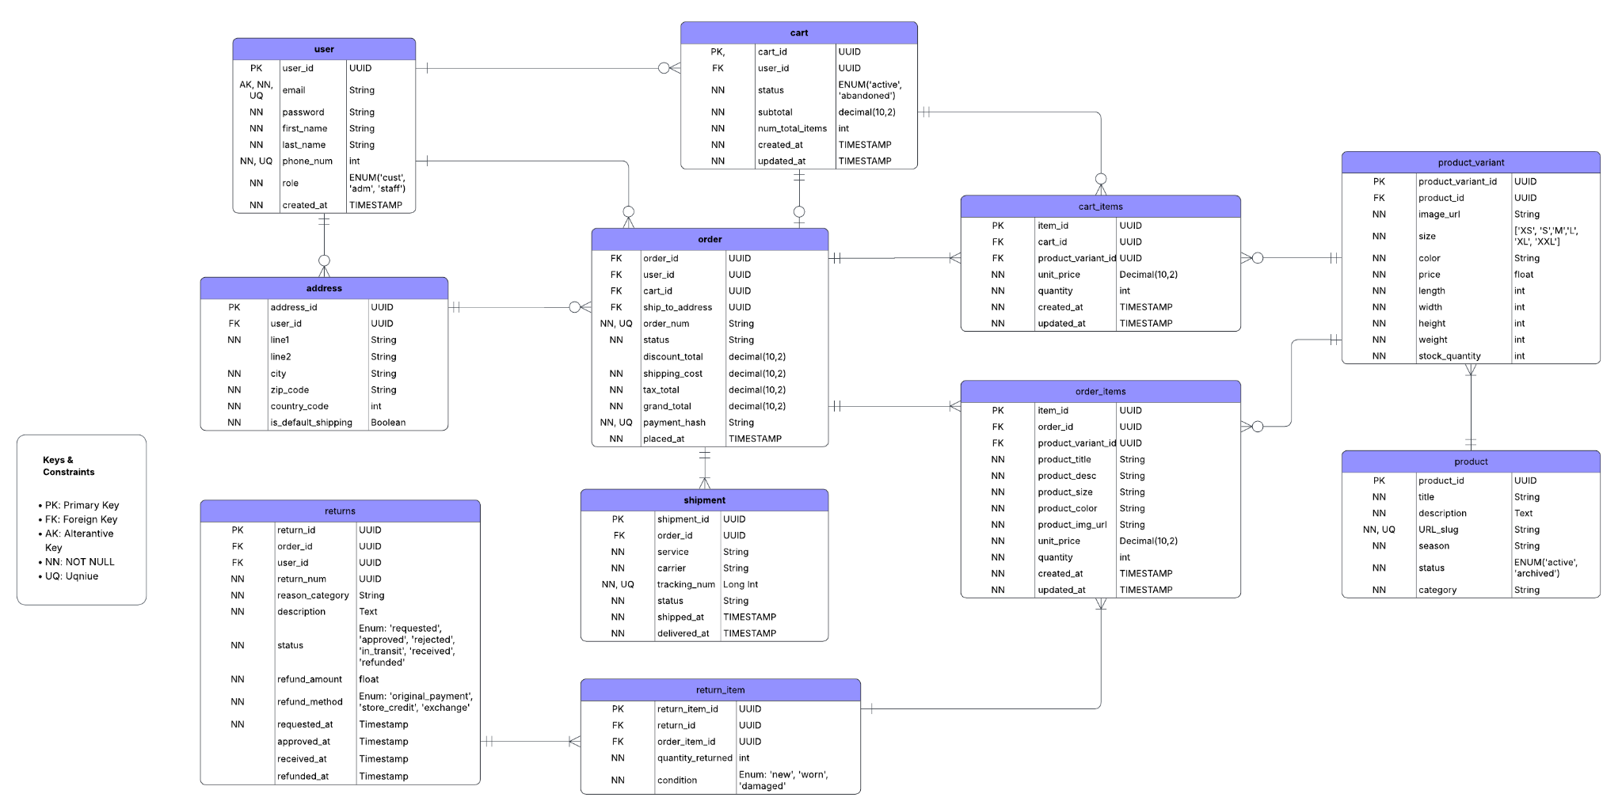

Slide 6
Time for the demo!

Slide 7
What were some issues we ran into?
There were some issues with routing the web pages due to errors popping up about specific files not existing in a directory
CSS also proved to be a challenging issue, as we wanted to make everything look nice and aligned

Slide 8
How did we overcome these issues?
For the routing issues, we fixed it by tracing the file path and organizing the hierarchy of the pages to keep things organized
We integrated the use of LLMs to aid us with the CSS

Slide 9
plans for second release
For the next version, we are planning on implementing logistics for checking out, creating orders, and make the tracking page functional
We would also like to add product images, and to populate the tables more, since the only tables that were populated for this release were products, product variants, and users

Slide 10
Plans for third release
For the third release, we want to implement user accounts and authentication, a payment layer with Stripe and Google authentication in order to simulate a real order.
Adding the ability for verified users to post reviews on items could also be beneficial.

